Slide 1

PROJECT NAME- E-retail factors for customer activation and retention: A case study from Indian e-commerce customers
Submitted by-
Dishant Doshi

Slide 2
INTRODUCTION
Customer satisfaction has emerged as one of the most important factors that guarantee the success of online store; it has been posited as a key stimulant of purchase, repurchase intentions and customer loyalty. A comprehensive review of the literature, theories and models have been carried out to propose the models for customer activation and customer retention. Five major factors that contributed to the success of an e-commerce store have been identified as: service quality, system quality, information quality, trust and net benefit. The research furthermore investigated the factors that influence the online customers repeat purchase intention. The combination of both utilitarian value and hedonistic values are needed to affect the repeat purchase intention (loyalty) positively.
Background of Dataset
The data is collected from the Indian online shoppers. Results indicate the e-retail success factors, which are very much critical for customer satisfaction

Slide 3
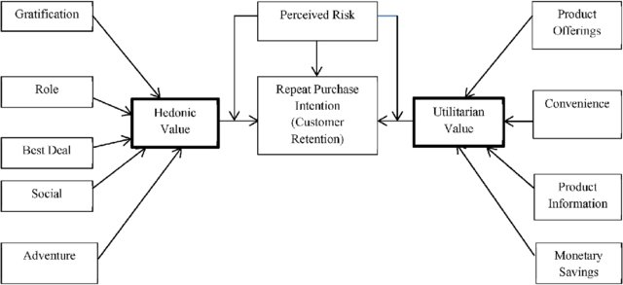
Diagram Representation of Customer Retention
The hedonic value have 4 values that is gratification, role, best deal, social, adventure
The Utilitarian have four values product offering, Convenience, Product Information, Monetary Saving
The customer retention based on three main factor Hedonic value, Perceived Risk, Utilitarian

Slide 4
Hardware And Software Requirement
For hardware I have used my laptop for doing EDA
For Software I have used Google colab because of it speed it gives high ram and storage space
And for rest of EDA I have used some library like
Pandas
Numpy
Seaborn
Matplotlib

Slide 5
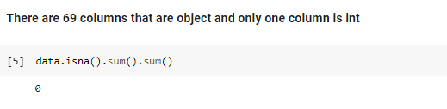
Dataset and Analysis
This dataset has only one column that was int and rest of all the columns are object the shape of data is 267 rows and 71 columns
Missing Values in dataset
There is no missing values in dataset

Slide 6
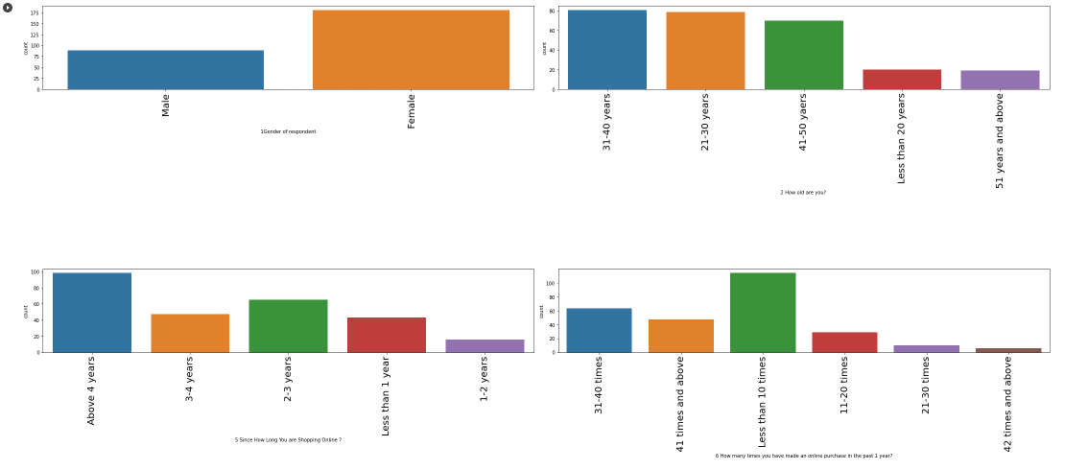
EDA
I have did EDA using countplot for every feature so I can get knowledge about which value in every feature I most popular

Slide 7
Observation
1-From gender i can say male are less and female are more means female use to do more shopping
2-From age 21-30 and 31-40 years of people use to do more shopping and peoples who are 50 years old and above they do very less shopping
3-From Since How Long You are Shopping Online i can say peoples at the age of 4 years start online shopping
4-From How many times you have made an online purchase in the past 1 year i can say less then 10 times has high count and and 42 times and above have least count means mostly people buy less then 10 mines a year

Slide 8
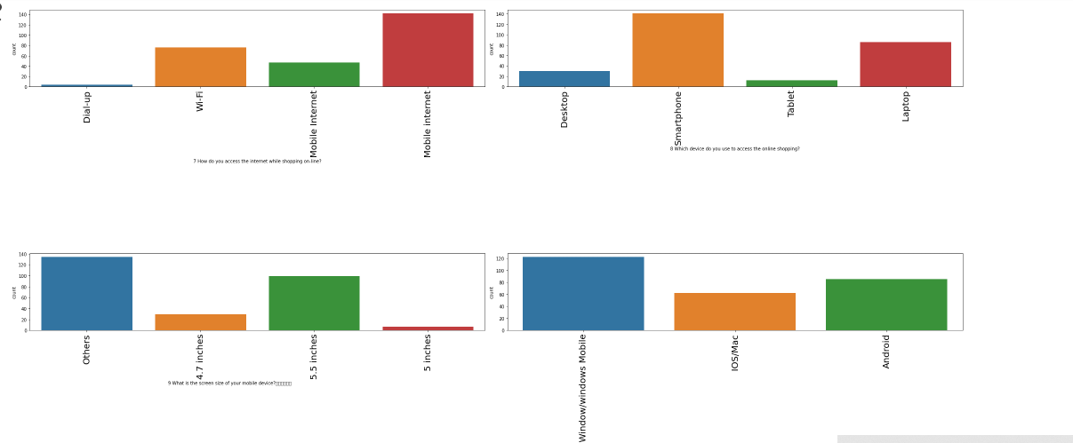
5-From How do you access the internet while shopping on-line we can see people used to buy using mobile internet more and very few use dialup
6-From Which device do you use to access the online shopping i can say people use there smartphones more then laptops and very few uses tablet
7-From What is the screen size of your mobile device i can say other have the highest count then 5.5 intch has the hihest count and least 5 intch
8-From What is the operating system (OS) of your device i can say mostly people use window phones then android and then less people use ios for inline shopping

Slide 9
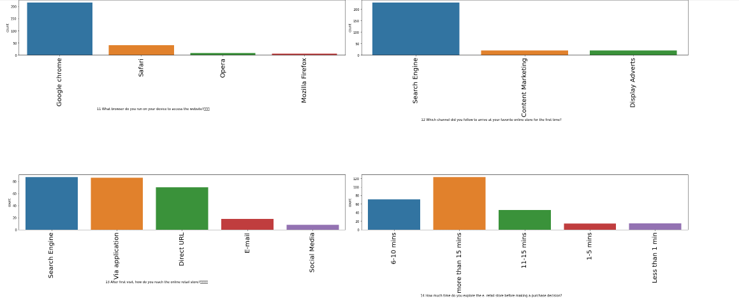
9-From What browser do you run on your device to access the website i can say mostly all people use google crome and very less people use firefox
10-From Which channel did you follow to arrive at your favorite online store for the first time People mostly use search engine to buy something
11-From After first visit, how do you reach the online retail store i can say people used search engine or app for this
12-From How much time do you explore the e- retail store before making a purchase decision i can say mostly people use to take 15 min and very few people take 1 min only

Slide 10
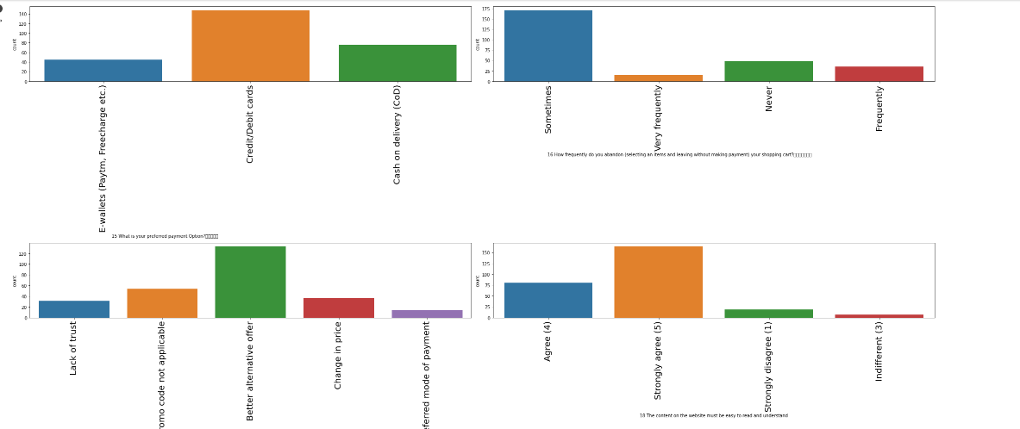
13-From What is your preferred payment Option i can say mostly people use credit/debit card then 2nd preference of people are cash on delivery then least they use E-wallet
14-From How frequently do you abandon (selecting an items and leaving without making payment) your shopping cart i can say the highest count have sometimes and the least count have very frequently
15-From Why did you abandon the “Bag”, “Shopping Cart i can say better offer has the high count means people get some other best offer and it has least count of lack of trust and no preferred payment means people don't have trust and they dont find there best preffered method
16-From The content on the website must be easy to read and understand people have voted more for strongly agree and agree they want while shopping they can easily read the content of site

Slide 11
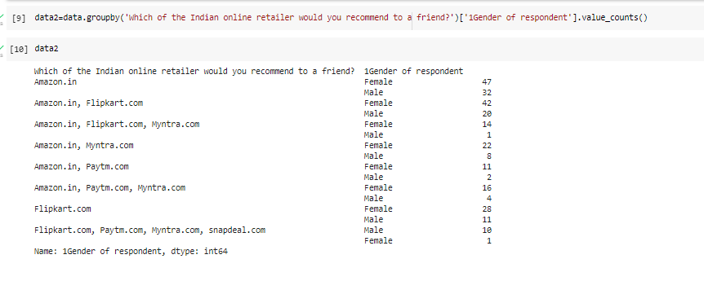
Gender vs Which of the Indian online retailer would you recommend to a friend
Male has less count as compare to female and mostly people use to recommend amazon to there friends after amazon people recommend flipkart and very less people recommend paytm and snapdeal

Slide 12
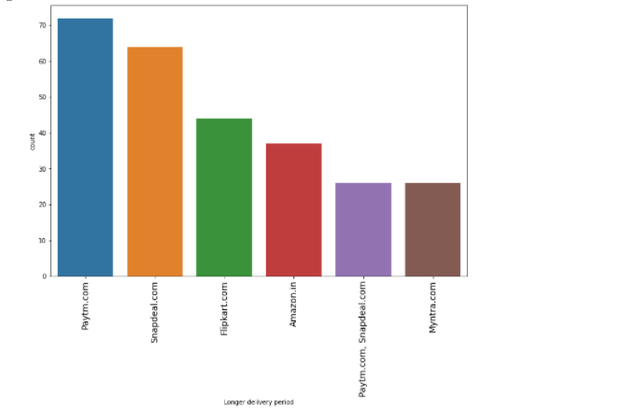
Which store has longest delivery period
By seeing the graph i can say paytm take very long time to deliver items then sanpdeal then flipkart and then amazon and all

Slide 13
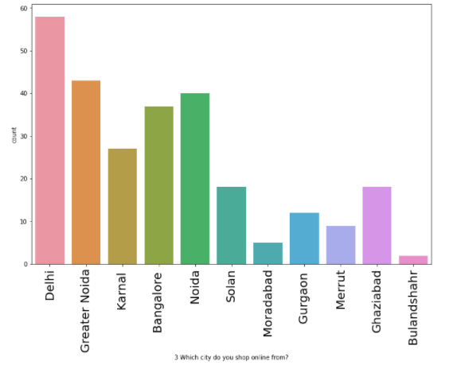
Which city people do shop online from?
*From upper graph i can say Delhi has the highest count means
people in Delhi order more
*after Delhi greater Noida has 2nd highest count
*and least count is Bulandshahr means people who live in Bulandshahr usually buy less online items

Slide 14
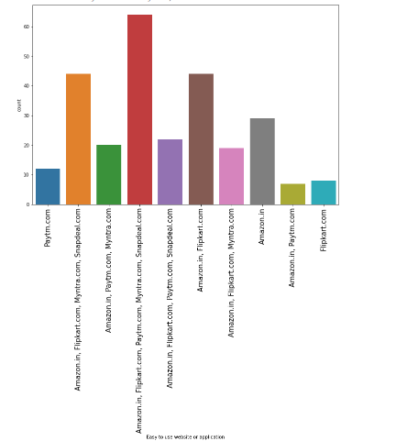
Easy to use website or application
From upper graph i can say that values who have single variable amoung these only amazon have high count as compare to other and paytm has less count

Slide 15
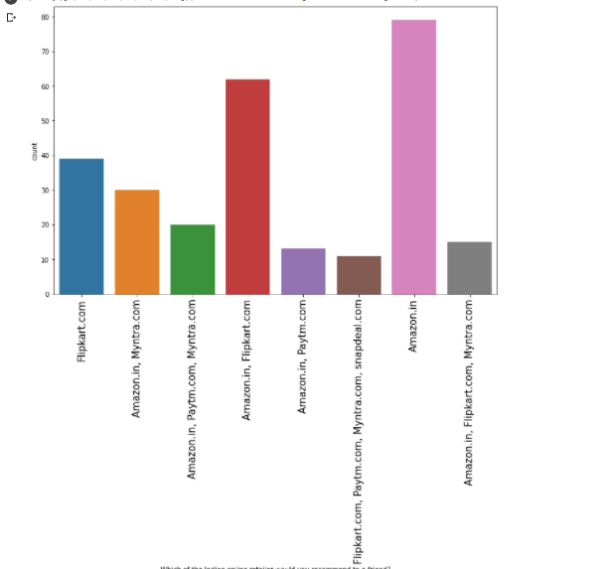
Limited mode of payment on most products (promotion, sales period)
From upper graph i can say snapdealhas the limited mode of payment and paytm has the least count

Slide 16
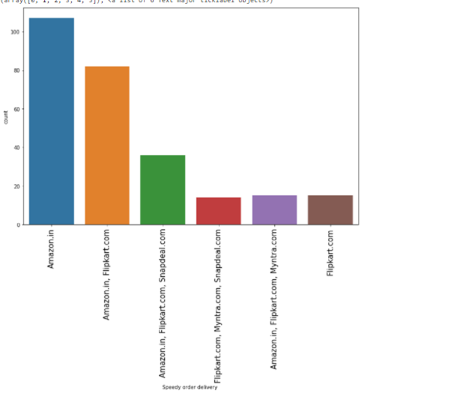
Which of the Indian online retailer people recommend to a friend
From upper graph i can say most of the people recommend amazon to there friend after amazon people also recommend flipkart

Slide 17
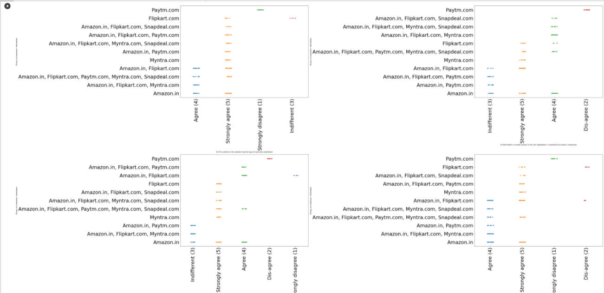
All Site vs terms of different sites
1-From Site vs 18 The content on the website must be easy to read and understand i can say every site is strongly agree except PAYTM
2-From Site vs Information on similar product to the one highlighted is important for product comparison PAYTM is disagree and amazon and flipkart and snapdeal is strongly agree
3-From sites vs Complete information on listed seller and product being offered is important for purchase decision Paytm is disagree and other is agreed
4-From sites vs All relevant information on listed products must be stated clearly Paytm is disagree and other are agree

Slide 18
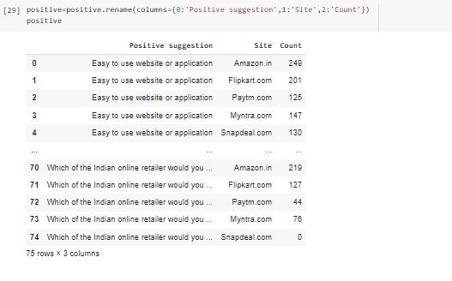
Positive review by all user for different sites
*From this table we can see positive review with there count
*Count play a very important role here it shows which value means which term people have voted more like amazon gives fast delivery etc.

Slide 19
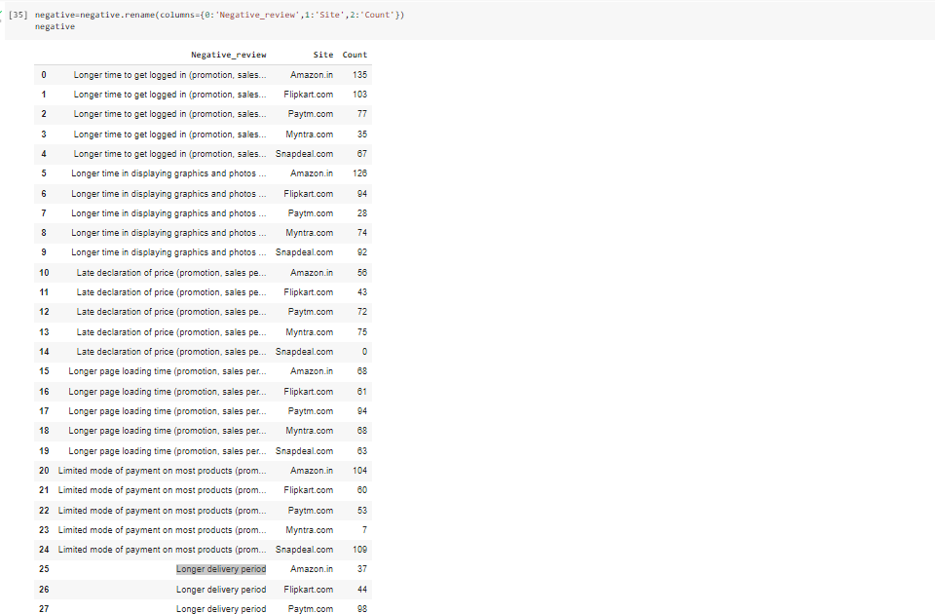
Negative review of peoples
From this table we can see how many people have voted negative review as per different sites
There are some negative review that are also in positive review like delivery time some people have voted delivery is fast in positive review but here also some people have voted negative for delivery we can say may be because of some reason delivery may get extended but if we see overall the count of positive delivery is high as compare to negative delivery.

Slide 20
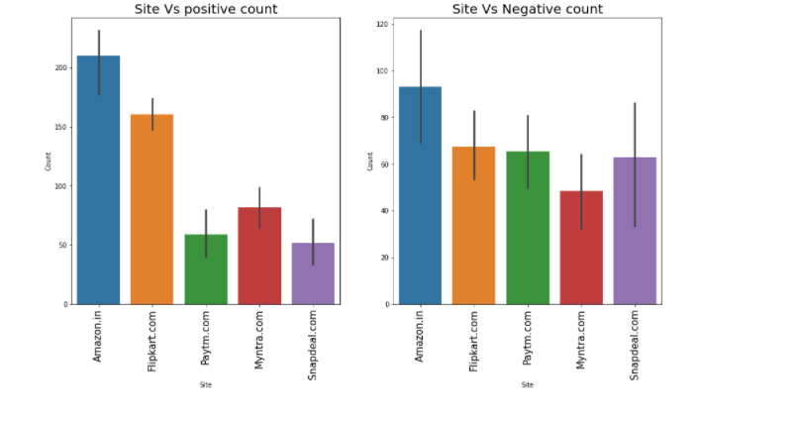
Positive Vs Negative review count
1-i can say amazon has got high positive review as well as high negative review also but positive have high count as compare to other
2-same with flipkart and myntra
3-but paytm and snapdeal has got less positive review but high negative review

Slide 21
Conclusion
1-Amazon
To improve things
1-Reduce longer time to login
2-Reduce Longer time in displaying graphics and
photos
3-Late declaration of price
4-Reduce Longer page loading time
5-More payment options
6-Reduce Longer delivery period
Positive Feedback Review
1-Easy to use website or application
2-Visual appealing web-page layout
3-Wild variety of product on offer
4-Complete, relevant description information of product
5-Fast loading website speed of website
6-Reliability of the website or application
7-Quickness to complete purchase
8-Availability of several payment options
9-Speedy order delivery
10-Privacy of customers’ information
11-Security of customer financial information
12-Perceived Trustworthiness
13-Presence of online assistance through multi-choice
14-Website is as efficient as before

Slide 22
FLIPKART
Positive
1-Easy to use website or application
2-Visual appealing web-page layout
3-Wild variety of product on offer
4-Complete, relevant description information of product
5-Fast loading website speed of website
6-Reliability of the website or application
7-Quickness to complete purchase
8-Availability of several payment options
9-Speedy order delivery
10-Privacy of customers’ information
11-Security of customer financial information
12-Perceived Trustworthiness
13-Presence of online assistance through multi-choice
14-Website is as efficient as before
15-Which of the Indian online retailer would you choose
Things to improve in flipkart
1-Longer time to get logged in
2-Longer time in displaying graphics and photos
3-Late declaration of price
4-Longer page loading time
5-Limited mode of payment on most products
6-Longer delivery period
7-Change in website/Application design
8-Frequent disruption when moving from one page to another

Slide 23
Paytm.com
Positive Suggestion with count
1-Easy to use website or application 125
2-Visual appealing web-page layout 67
3-Wild variety of product on offer 20
4-Complete, relevant description information of product 59
5-Fast loading website speed of website 99
6-Reliability of the website or application 96
7-Privacy of customers’ information 68
8-Security of customer financial information 88
9-Perceived Trustworthiness 24
10-Presence of online assistance through multi-choice 25
11-Website is as efficient as before 58
12-Which of the Indian online retailer would you choose 44
Negative
Negative review with count
1-Longer time to get logged in 77
2-Longer time in displaying graphics and photos 28
3-Late declaration of price 72
4-Longer page loading time 94
5-Limited mode of payment on most products 53
6-Longer delivery period 98
7-Change in website/Application design 63
8-Frequent disruption when moving from one page to another 39

Slide 24
Myntra
Reviews with count
Positive
1-Easy to use website or application 147
2-Visual appealing web-page layout 115
3-Wild variety of product on offer 64
4-Complete, relevant description information of product 64
5-Fast loading website speed of website 74
6-Reliability of the website or application 64
7-Quickness to complete purchase 79
8-Availability of several payment options 132
9-Speedy order delivery 29
10-Privacy of customers’ information 78
11-Security of customer financial information 91
12-Perceived Trustworthiness 88
13-Presence of online assistance through multi-choice 111
14-Website is as efficient as before 14
15-Which of the Indian online retailer would you choose 76
Negative
1-Longer time to get logged in 35
2-Longer time in displaying graphics and photos 74
3-Late declaration of price 75
4-Longer page loading time 68
5-Limited mode of payment on most products 7
6-Longer delivery period 26
7-Change in website/Application design 37
8-Frequent disruption when moving from one page 66

Slide 25
Snapdeal
Reviews with counts
positive
1-Easy to use website or application 130
2-Visual appealing web-page layout 61
3-Wild variety of product on offer 14
4-Complete, relevant description information of product 59
5-Fast loading website speed of website 81
6-Reliability of the website or application 45
7-Availability of several payment options 90
8-Speedy order delivery 50
9-Privacy of customers’ information 45
10-Security of customer financial information 100
11-Website is as efficient as before 25
Negative
1-Longer time to get logged in 67
2-Longer time in displaying graphics and photos 92
3-Late declaration of price 0
4-Longer page loading time 63
5-Limited mode of payment on most products 109
6-Longer delivery period 90
7-Change in website/Application design 8
8-Frequent disruption when moving from one page 74
NOTE-All people facing almost similar kind of problem with different site but i have mentioned count so if more people are facing similar count then the site should improve it if it has a less count no need to do anything

Slide 26
THANKYOU

